Slide 1
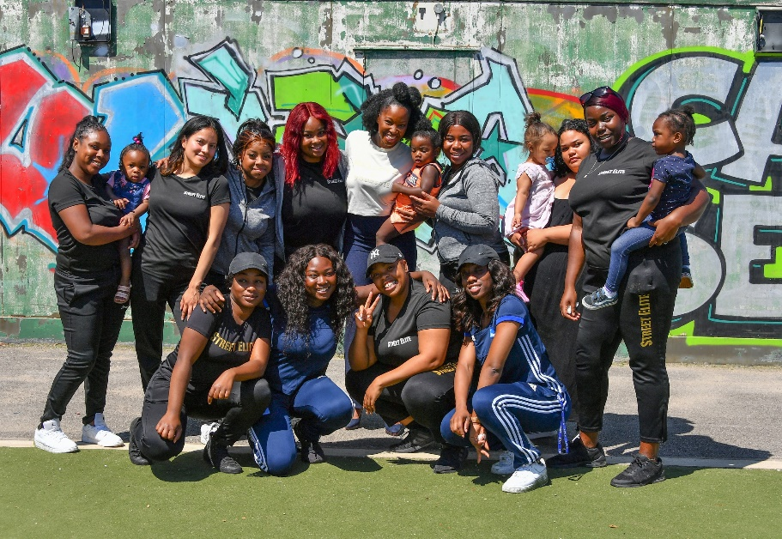
London Funders – Supporting Resilience Forum Berkeley Foundation’s Resilience Fund
Tuesday 22 March 2022

Slide 2
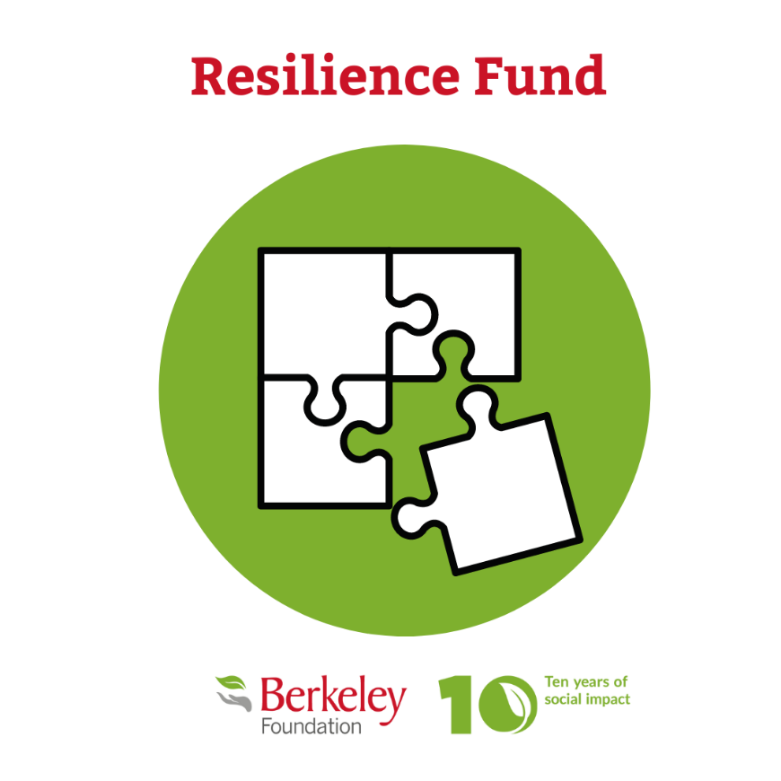
London funders – supporting resilience forum
The journey so far
The Resilience Fund Learning Programme
Introduction to the Foundation and our 2030 strategy
What is the Resilience Fund?

Slide 3
London funders – supporting resilience forum
Berkeley Foundation
Who we are & our 2030 strategy

Slide 4
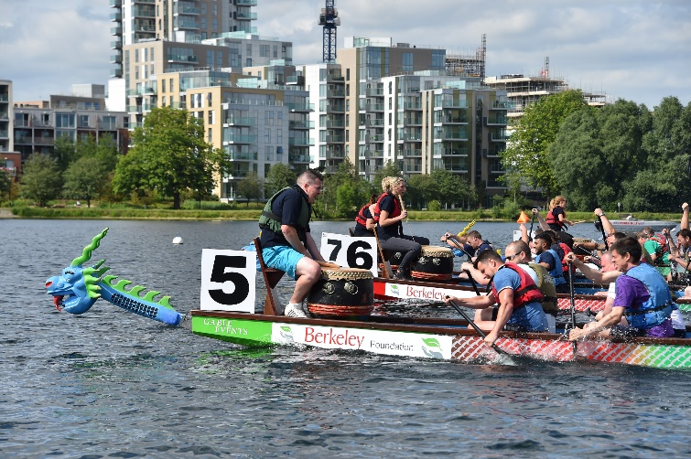
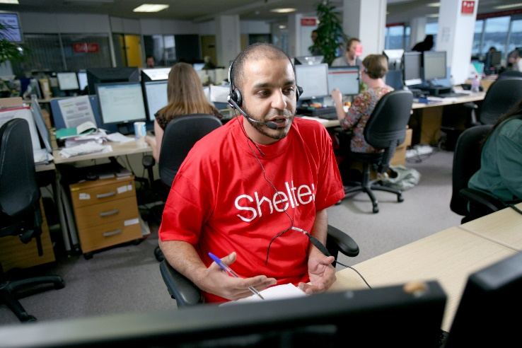
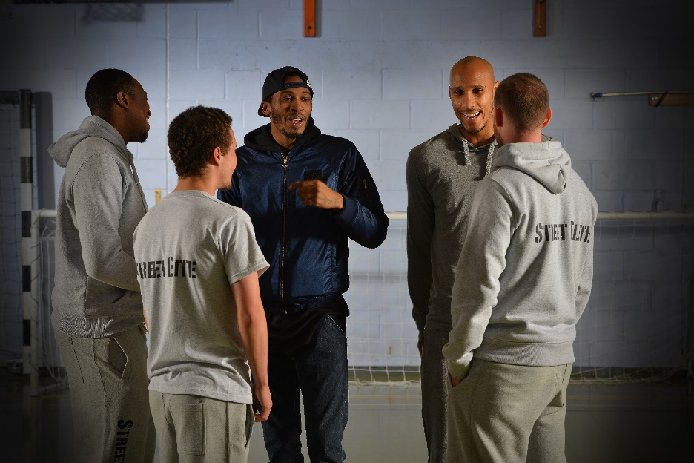
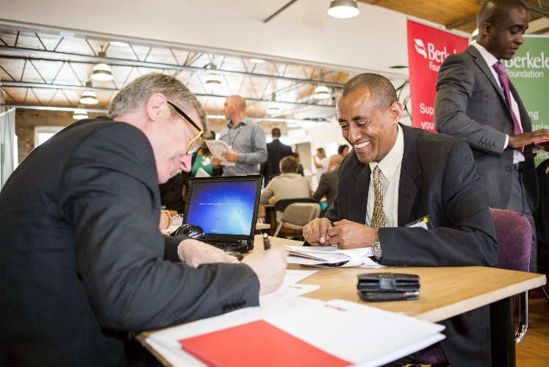
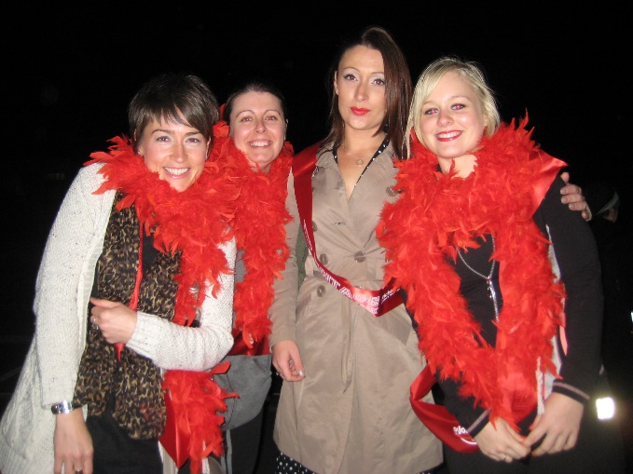
London funders – supporting resilience forum
Ten years of social impact – from then…
2011 - Berkeley Foundation established to support young people, families and communities in the areas where Berkeley works

Slide 5
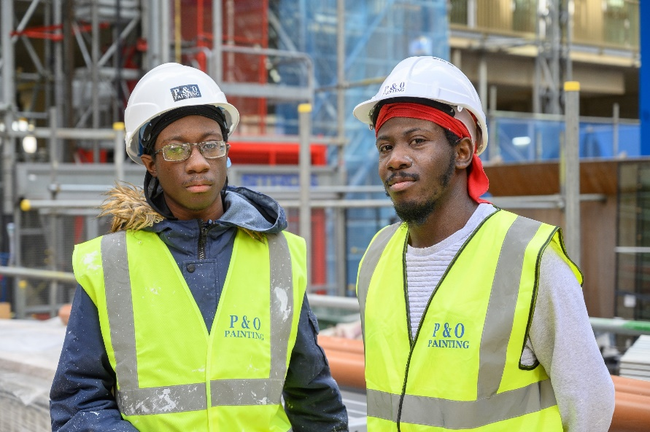
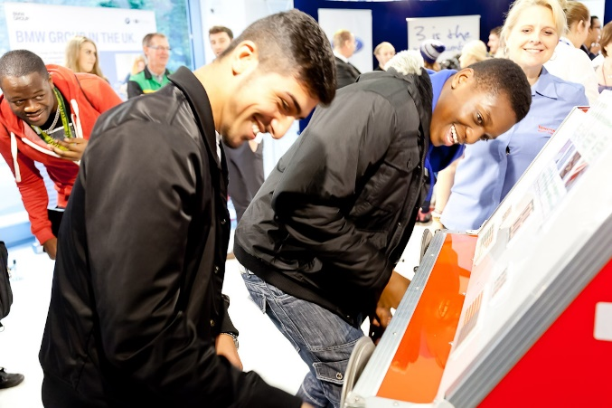
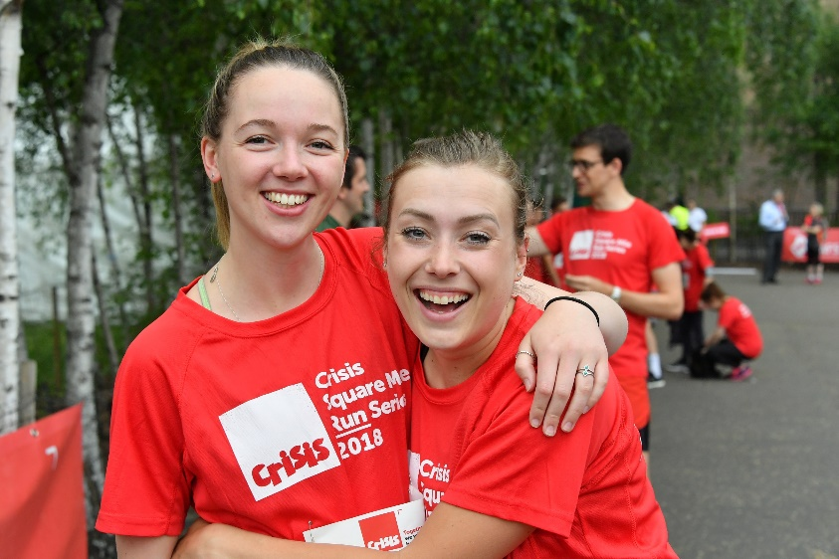
The Berkeley foundation
… to now
2021 – Over £20 million given to support expert charities in our local communities, directly reaching more than 33,000 people.

Slide 6
“Our vision is that young people and their communities will have the tools and resources they need to thrive and be a force for change in the world.”
2030 vision
1. A safe place to call home
2. Journey to employment
3. Health and wellbeing
4. Youth leadership
Five impact goals
underpinned by
5. A resilient voluntary sector
Five commitments about the way we’ll work
1. We’ll work in partnership with expert charities, investing in their work to help young people thrive
2. We’ll add value to our partnerships through our expertise, networks and relationship with Berkeley Group
3. We’ll learn from our work and share our learning across the public, private and voluntary sectors
4. We’ll ensure that diversity, equity and inclusion is at the heart of everything we do
5. We’ll enable young people to play an active role in the Foundation’s work
Our mission
“Our mission is to use all our resources to support organisations, young people and communities to have a positive impact in the areas where Berkeley Group works.”
Have integrity
Be effective
Be bold
Empower people
Progress through
learning
Our values

Slide 7
London funders – supporting resilience forum
Resilience Fund

Slide 8
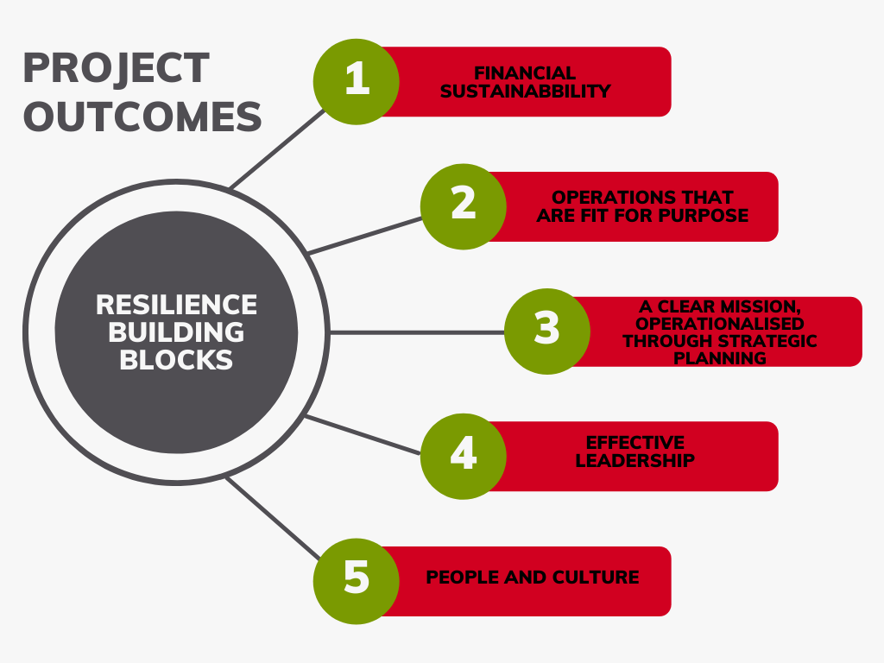
London funders – supporting resilience forum
Organisational resilience is ‘the ability of an organisation to anticipate, prepare for, respond and adapt to incremental change and sudden disruptions in order to survive and prosper” .
(Cranfield University, 2017)

Slide 9
London funders – supporting resilience forum
Eligibility criteria
Income | £100,000 - £1.5m At least one year of published accounts
Geography | Greater London, Berkshire, Buckinghamshire, Hertfordshire, Oxfordshire, Surrey, Kent, Hampshire, West Sussex, West Midlands, Warwickshire and the City of Birmingham
Focus | Organisations supporting young people, aged 16-25, on their journey to employment
Particularities | Commitment to long-term organisational development Not a recipient of the Foundation’s Capacity Building Fund

Slide 10
London funders – supporting resilience forum
The journey so far

Slide 11
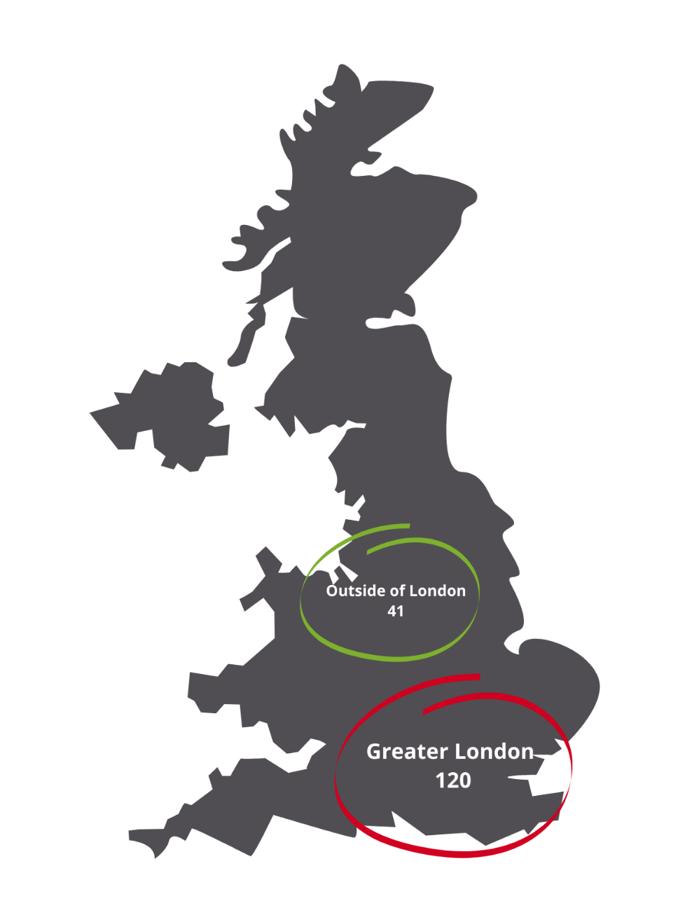
London funders – supporting resilience forum
Income and geography

Slide 12
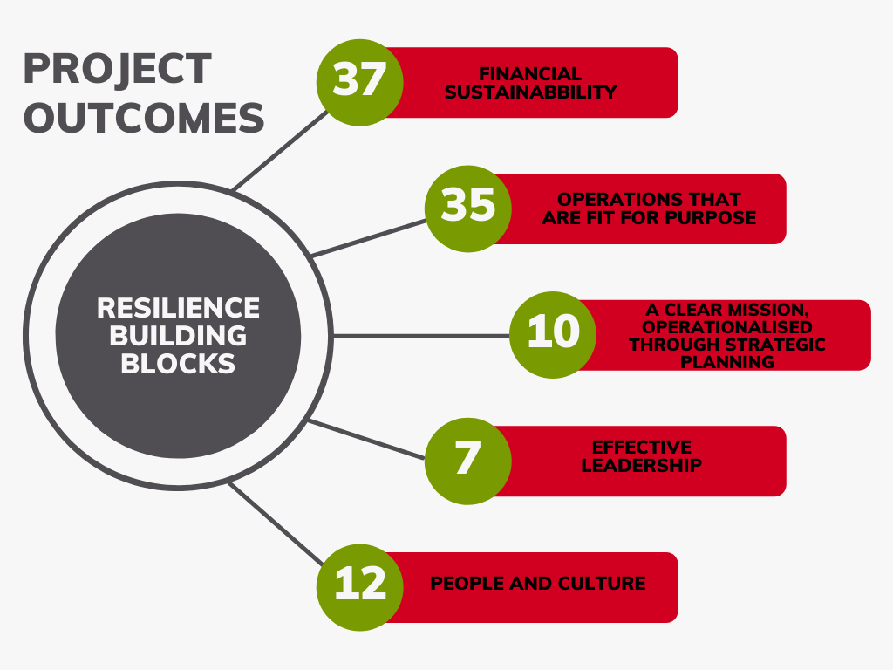
London funders – supporting resilience forum
Focus

Slide 13
London funders – supporting resilience forum
Headlines
The two most frequent asks relate to ‘Finance sustainability’ (in particular fundraising capacity) and ‘Operations that are fit for purpose’ (in particular the know-how around capturing and disseminating impact)
Clear, detailed and defined funding guidelines and other interactive resources (webinars, one-on-one calls, etc.) are key to supporting prospective partners to interact with and apply to non-programmatic funding.
The rolling applications process enabled us to reach more audiences and to overcome challenges (i.e. slow uptake from organisations outside London, lengthier application process that benefits smaller organisations).

Slide 14
London funders – supporting resilience forum
Defining ‘resilience’ Is this the right terminology? How is resilience building different to capacity building or unrestricted funding? Individual vs organisational resilience? | Programme impact What does success look like? How do we measure the impact of this intervention?
Programme sustainability Is resilience building a long-term process? How do we ensure continuation funding? How do funders contribute to resilience building? | Culture of ‘resilience’ Should the process start from top to bottom, or from bottom to top? What is the importance of external resources (consultants, collaboration, etc.)
The Resilience Fund Learning Programme
At least two learning events a year;
Peer support groups;
One-on-one catch ups and visits with Partnership Managers;
Annual report.

Slide 15
Thank you!
Any questions?
Contact us at sally.dickinson@berkeleyfoundation.org.uk and cristina.otelea@berkeleyfoundation.org.uk

